Slide 1
Daily routine

Slide 2
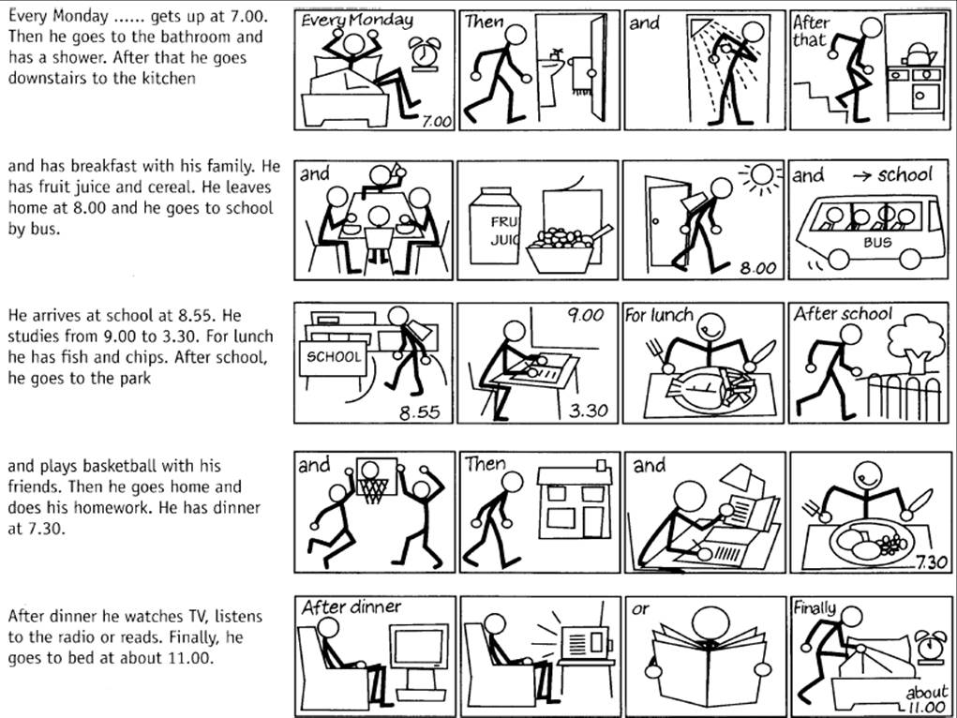

Slide 3
1 | 2 | 3 | 4
5 | 6 | 7 | 8
9 | 10 | 11 | 12
13 | 14 | 15 | 16
17 | 18 | 19 | 20

Slide 4
Verbs relating to squares:
1. to wake up
2. to take a shower
3
4
5
6
…

Slide 5
Sentences relating to verbs
1. I wake up.
2. I take a shower
3
4
5
6
…

